Slide 1
Today = 03-03-2021
จุดเสี่ยงย้อนหลัง 7 วัน
Step1
Step2
Output
Data Output: Location_name, lat, long
Data Input: Lat, long
Concept output หนึ่งคน หนึ่งจุด หนึ่งครึ่ง
Condition 1. daterisk_end [ภายใน 7 วัน] between 25-02-2021 and 03-03-2021
Source:
[TB_QR_TimeStamp]
[TB_Checkin_PG]
[TB_SR_Covid_location]
Condition:
Distance 100m (0.00085)
Check-In Date: 02-03-2021
3 Source data (Emp_CheckIn, PG_CheckIn,Beverest log)

Slide 2
Step1: จุดเสี่ยงย้อนหลัง 7 วัน
declare @date date = cast((getdate()-6) as date)
select
place
,daterisk_end
,daterisk
,lat
,lng
,p_name_t
,a_name_t
,t_name_t
,id
,category
from [SR_APP].[dbo].[TB_SR_Covid_Risk_Location]
where daterisk_end between @date and daterisk_end
order by daterisk desc

Slide 3
Step2: Traceability
Condition
หากรันวันนี้ 03-03-201 จะต้องใช้ข้อมูลคนเช็คอินวันที่ 02-03-2021 (เมื่อวาน)
รัศมีการค้นหา 100m
การรันเป็นรูป แบบ For loop 1 จุดเสี่ยงต่อ 1 การ รัน Trace
from ( /* QR check in*/
SELECT TS.[EmployeeId]
,cast(TS.CreatedDateTime as date) [CheckinDate]
,TS.CreatedDateTime [CheckinDatetime]
,Loc.LocationNameTH
,TS.ShopName
,coalesce(Loc.LocationNameTH, case when TS.ShopName = '' then NULL else TS.ShopName end ) LocationName
,[UserLat] as [latitude]
,[UserLong] as [longitude]
FROM [SR_APP].[dbo].[TB_QR_TimeStamp] TS
left join [SR_APP].[dbo].[TB_QR_Location] Loc on Loc.LocationId = TS.LocationId
where cast(TS.CreatedDateTime as date) between @dateFrom and @dateTo
and cast([UserLat] as float) between @lat and @lat1
and cast([UserLong] as float) between @long and @long1
union /* PG check in*/
select A.[EmployeeId]
,cast(A.[CreatedDateTime] as date) as [CheckinDate]
,A.[CreatedDateTime] as [CheckinDatetime]
,A.[ShopName] [LocationNameTH]
,cast(A.[ShopId] as nvarchar(20)) ShopName
,A.[ShopName] [LocationName]
,[UserLat] as [latitude]
,[UserLong] as [longitude]
from [SR_APP].[dbo].[TB_Checkin_PG] A
where cast(A.[CreatedDateTime] as date) between @dateFrom and @dateTo
and cast(A.[UserLat] as float) between @lat and @lat1
and cast(A.[UserLong] as float) between @long and @long1
union /* Bev App Log */
select [employee_id]
,cast([create_date] as date) as [CheckinDate]
,[create_date] as [CheckinDatetime]
,' ' [LocationNameTH]
,' ' ShopName
,' ' [LocationName]
,[latitude] as [latitude]
,[longitude] as [longitude]
from [SR_APP].[dbo].[TB_SR_Covid_location]
where cast([create_date] as date) between @dateFrom and @dateTo
and cast([latitude] as float) between @lat and @lat1
and cast([longitude] as float) between @long and @long1
) MN
/* Declare Tracking Date Preriod */
--------------INPUT FILED---------------
declare @Location_Name nvarchar(255) = 'TBQ' ---<< ชื่อจุดเสี่ยงจาก Step1
declare @dateFrom date = cast(getdate()-1 as date) ---<< คนเช็คอินเมื่อวาน
declare @dateTo date = cast(getdate()-1 as date) ---<< คนเช็คอินเมื่อวาน
declare @LatIn float = 13.722714945425698 ---<< Latจาก Step1
declare @longIn float = 100.55962087617469 ---<< longจาก Step1
declare @daterisk_end date = '2021-03-01' ---<<วันที่วันสุดท้ายจาก Step1
declare @ID nvarchar(255) = '11001’ ---<< ID จุดเสี่ยงจาก Step1
--------------AUTO CALCUCATE-------------------
declare @Lat float = cast(cast(@LatIn as nvarchar) as float)-0.00085
declare @Lat1 float = cast(cast(@LatIn as nvarchar) as float)+0.00085
declare @long float = cast(cast(@LongIn as nvarchar)as float)-0.00085
declare @long1 float = cast(cast(@LongIn as nvarchar)as float)+0.00085
----------------------------------------------
/* List All Check-In Transaction in Risk Area */
select
@Location_Name Location_Name
,cast(getdate() as smalldatetime) Trace_datetime
,@Lat Location_Lat
,@long Location_Long
,MN.EmployeeId TO_EMP
,MN.latitude TO_LAT
,MN.longitude TO_LONG
,MN.CheckinDatetime TO_LOCATIONDATETIME
,@daterisk_end daterisk_end
,@ID ID
,concat(MN.EmployeeId,'_',@ID) REF

Slide 4
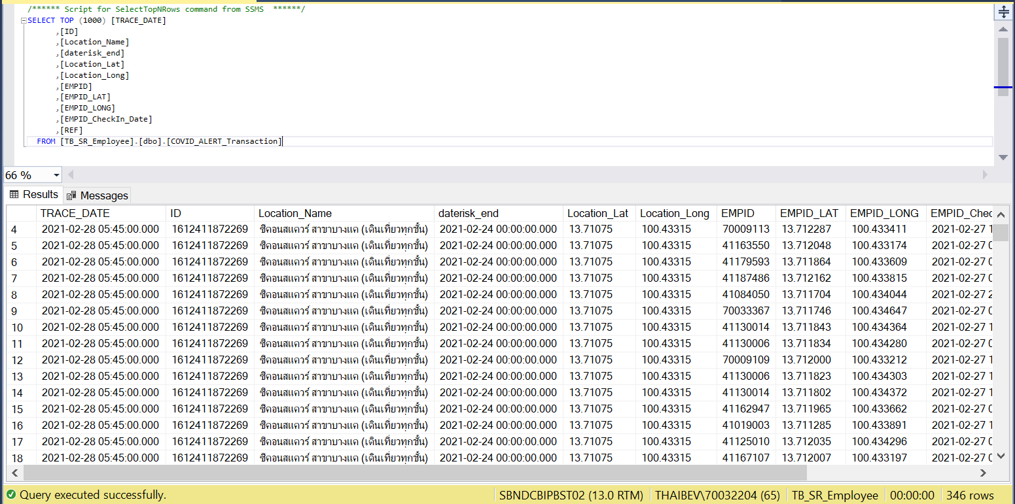
Step2: Traceability
นำ ผลขอการ Run traceability เก็บไว้ที่ DATABASE

Slide 5
Step3: Output
Concept หนึ่งคน หนึ่งจุด หนึ่งครึ่ง โดยดึงข้อมูลจาก Step2
declare @date date = dateadd(day, -1, cast(getdate() as date))
SELECT distinct A.[EMPID],A.Location_Name
FROM [TB_SR_Employee].[dbo].[COVID_ALERT_Transaction] A
left join (select * from [TB_SR_Employee].[dbo].[COVID_ALERT_Transaction] where cast([EMPID_CheckIn_Date] as date) <> @date) B on A.REF = B.REF
where cast(A.[EMPID_CheckIn_Date] as date) = @date and B.[EMPID] is null

Slide 6
ตัวอย่างการคำนวณจุดเสี่ยง ระยะ 100m (ใช้ค่าคงที่ 0.00085 ในการคำนวน)
1. จุดเสี่ยง TBQ : Lat = 13.722659, Long = 100.559606
2. สร้าง ช่วง Lat,long
Lat1 = 13.722659 – 0.00085 = 13.721809
Lat2 = 13.722659 + 0.00085 = 13.723509
Long1 = 100.559606 – 0.00085 = 100.558756
Long2 = 100.559606 + 0.00085 = 100.560456
3. นำมาหาพนักงานใกล้เคียงจุดเสี่ยง
where
Lat ของพนักงาน between lat1 and lat2
Long ของพนักงาน between long1 and long2

